Slide 2
Digraphs and Relations
Relations
Reflexive
Symmetric
Transitive
Equivalence Relations
Also Anti-Symmetric and Partial Order

Slide 3
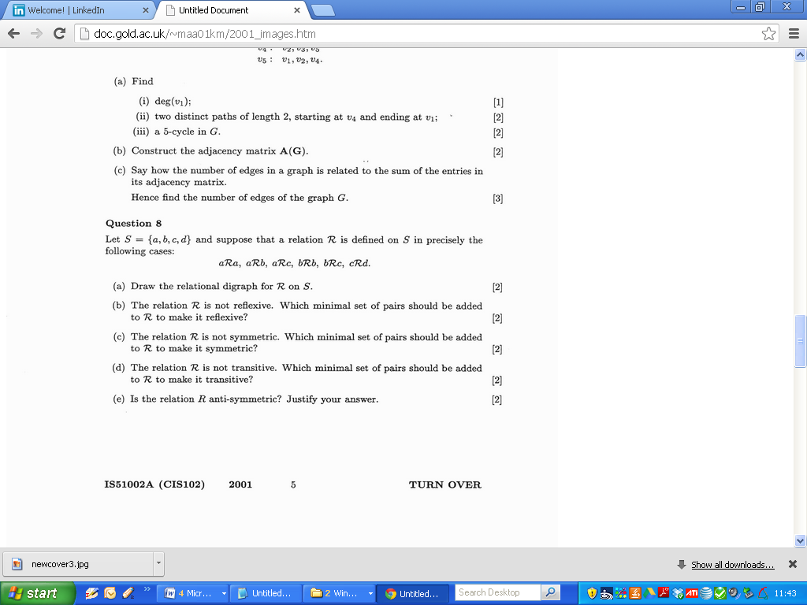
2001

Slide 4
2001

Slide 5
2001

Slide 6
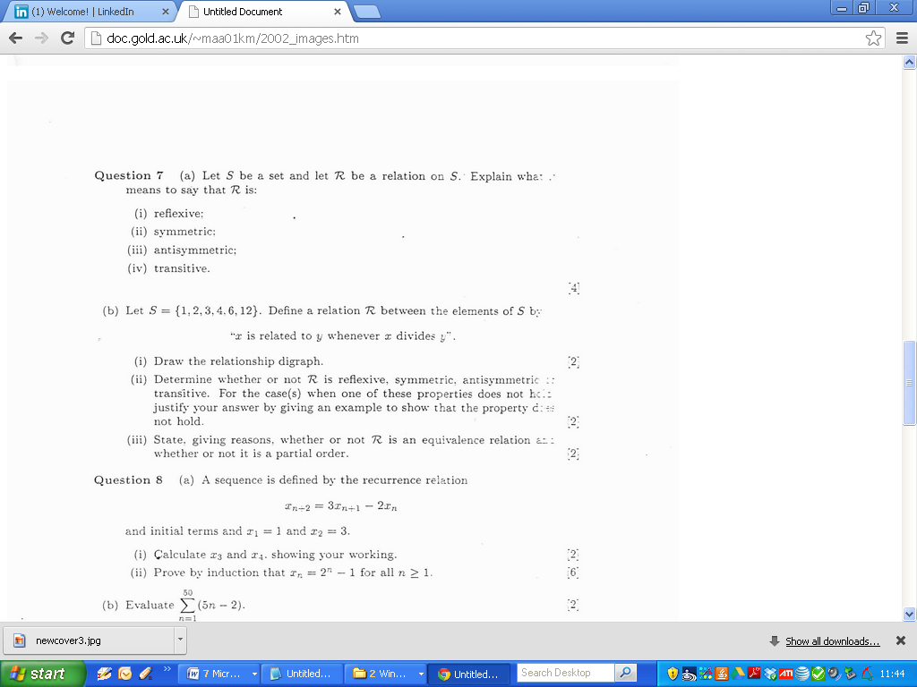
2002

Slide 7
2002

Slide 8
2002

Slide 9
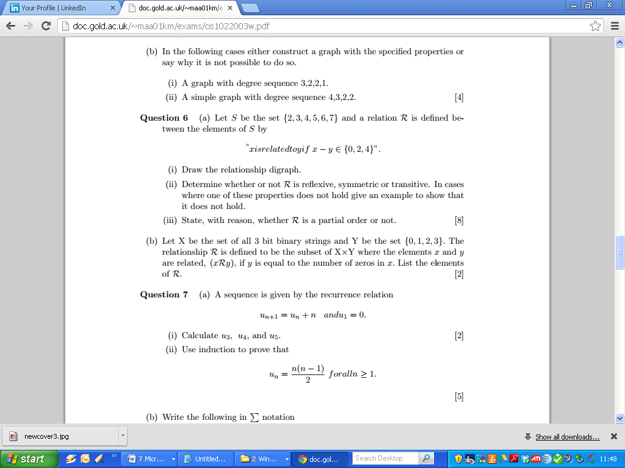
2003

Slide 10
2003

Slide 11
2003

Slide 12
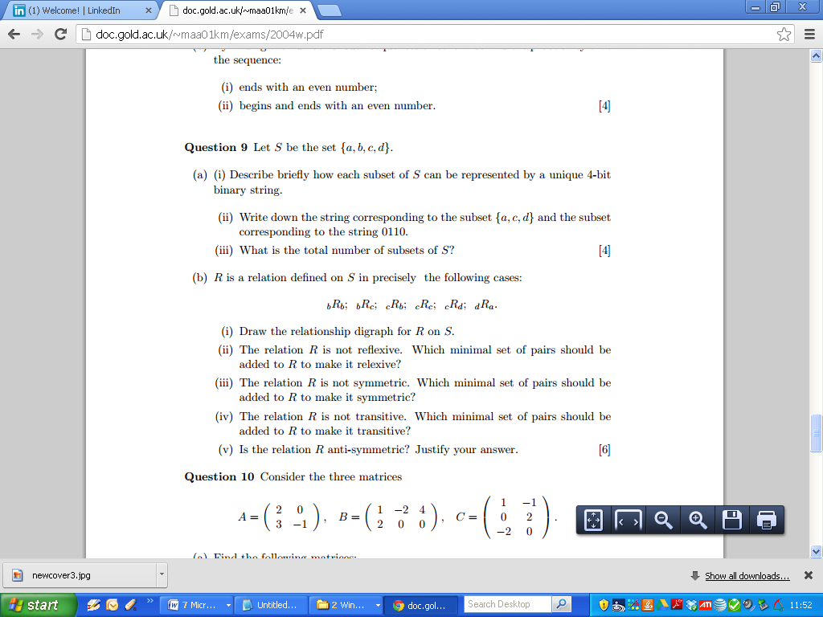
2004

Slide 13
2004

Slide 14
2004

Slide 15
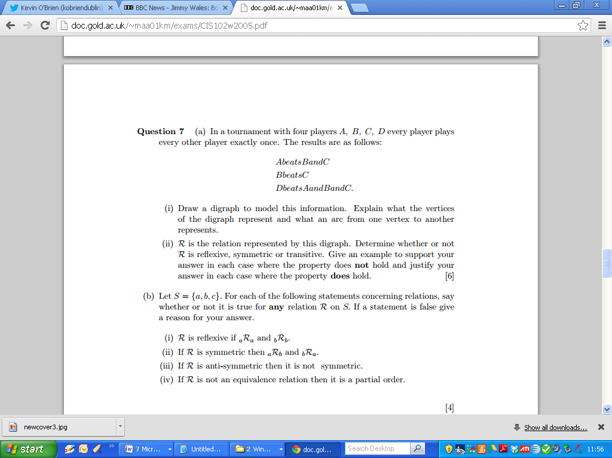
2005

Slide 16
2005

Slide 17
2005

Slide 18
2005

Slide 19
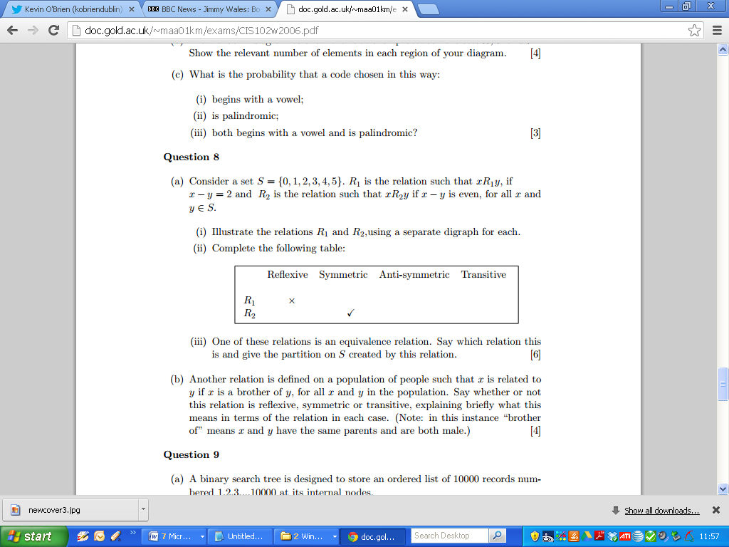
2006

Slide 20
2006

Slide 21
2006

Slide 22
2006

Slide 23
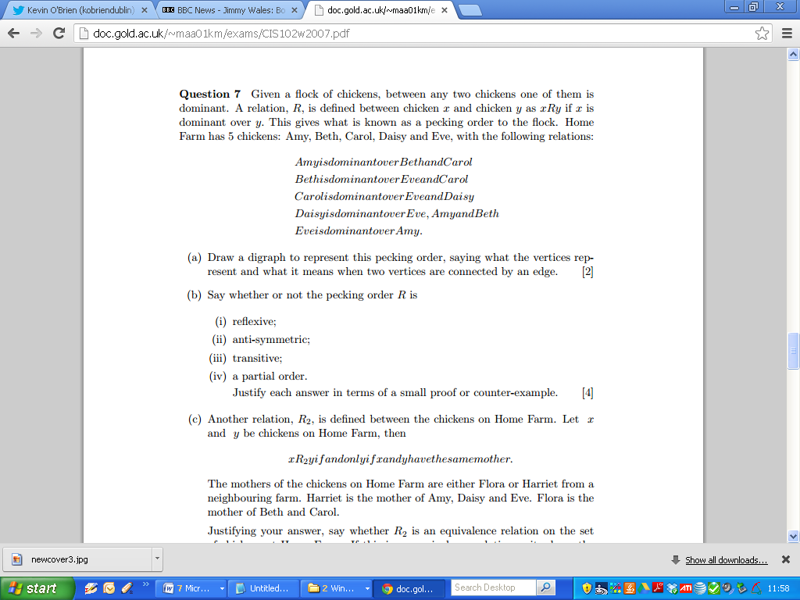
2007

Slide 24
2007

Slide 25
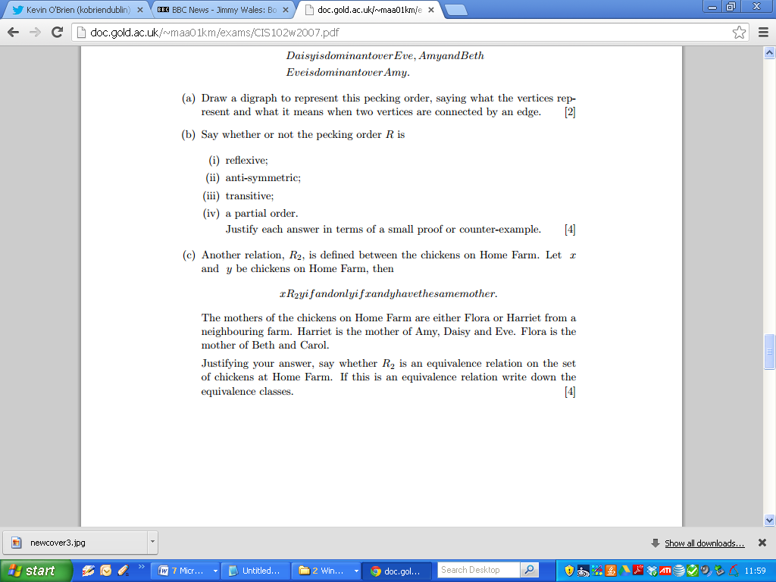
2007

Slide 26
2007

Slide 27
2007

